Slide 1
Create a Row Group
Lecturer: Ngo Huy Bien
Software Engineering Department
Faculty of Information Technology
VNUHCM - University of Science
Ho Chi Minh City, Vietnam
nhbien@fit.hcmus.edu.vn

Slide 2

Objectives

Slide 3

Contents

Slide 4

References
Brian Larson (2017). Microsoft SQL Server 2016 Reporting Services. McGraw-Hill Education.

Slide 5
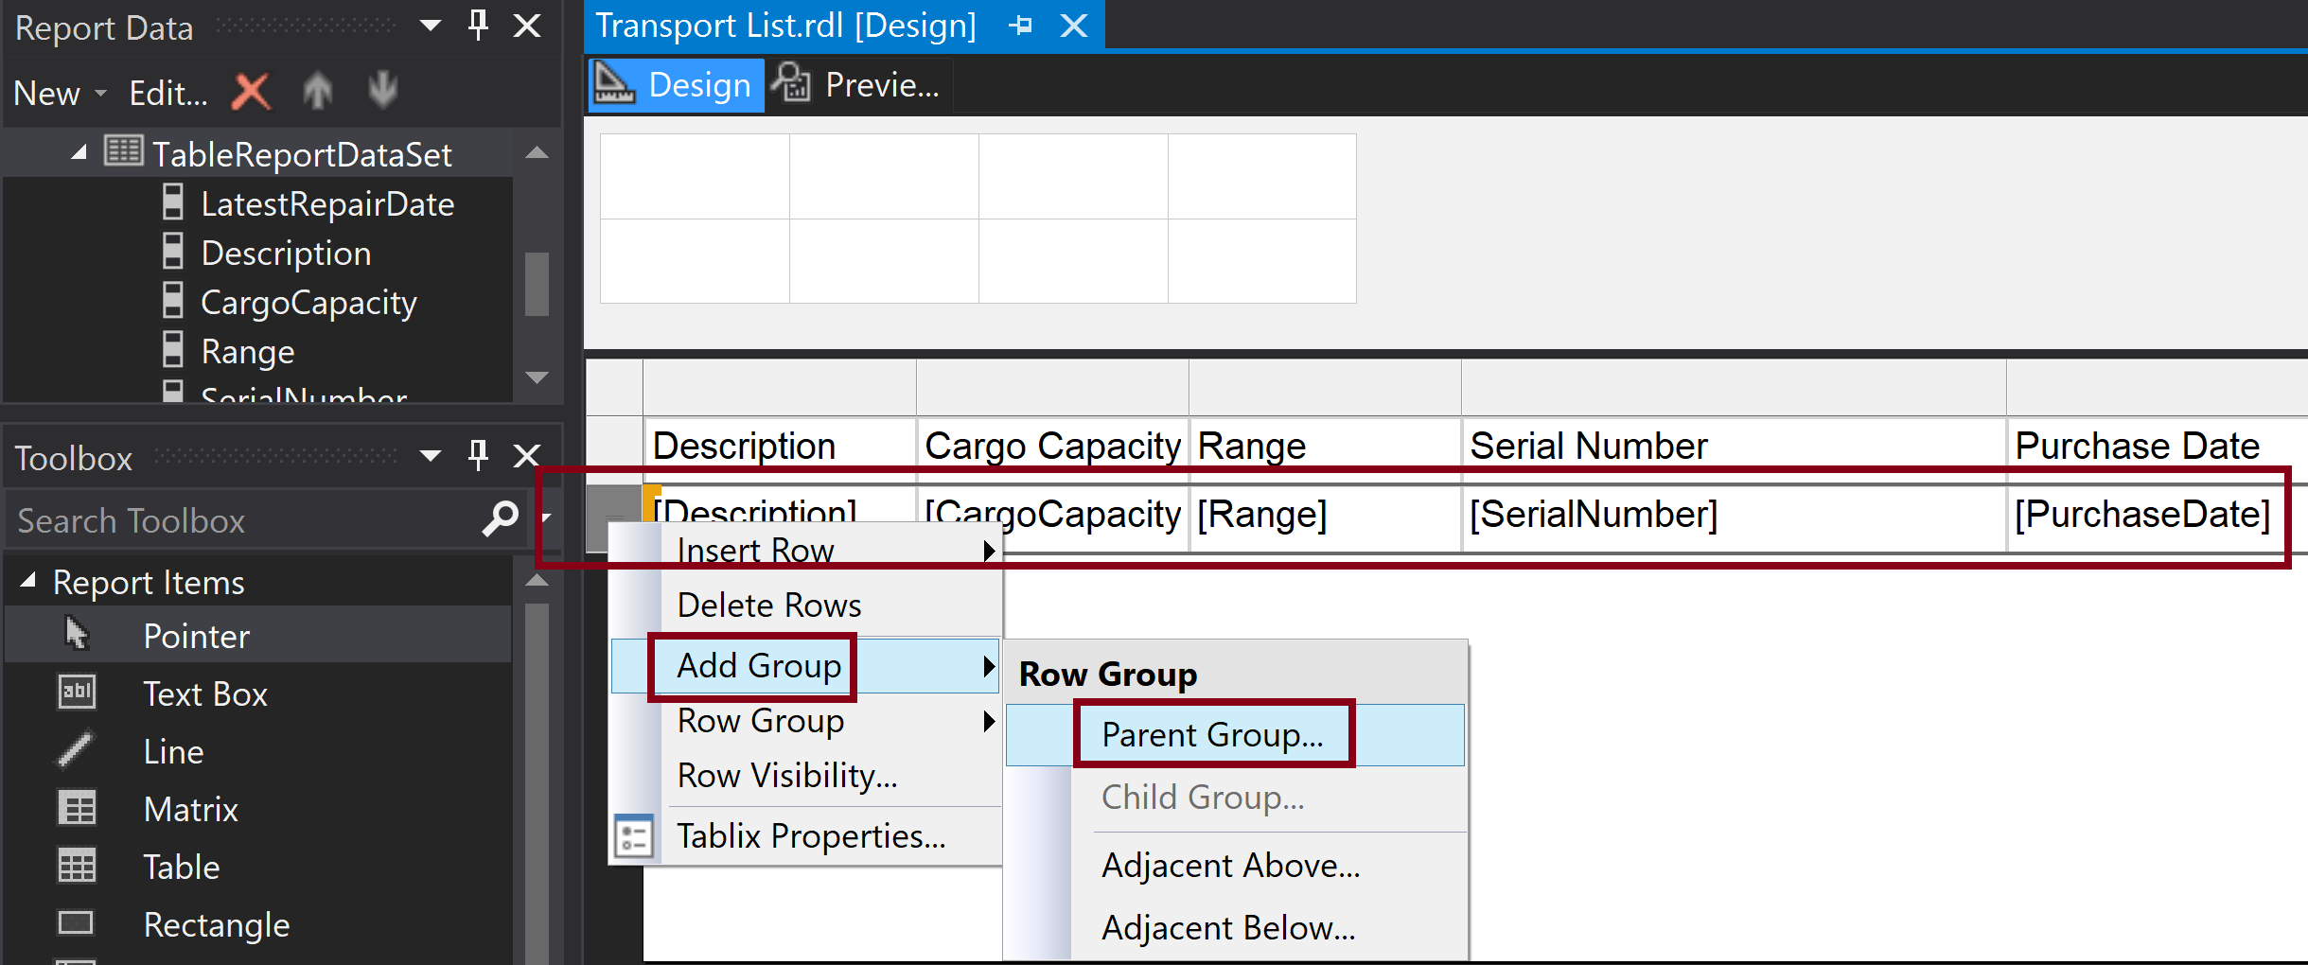
1. Add Row Group (I)
Assume that a table report is being editted.
Right click the first row.

Slide 6
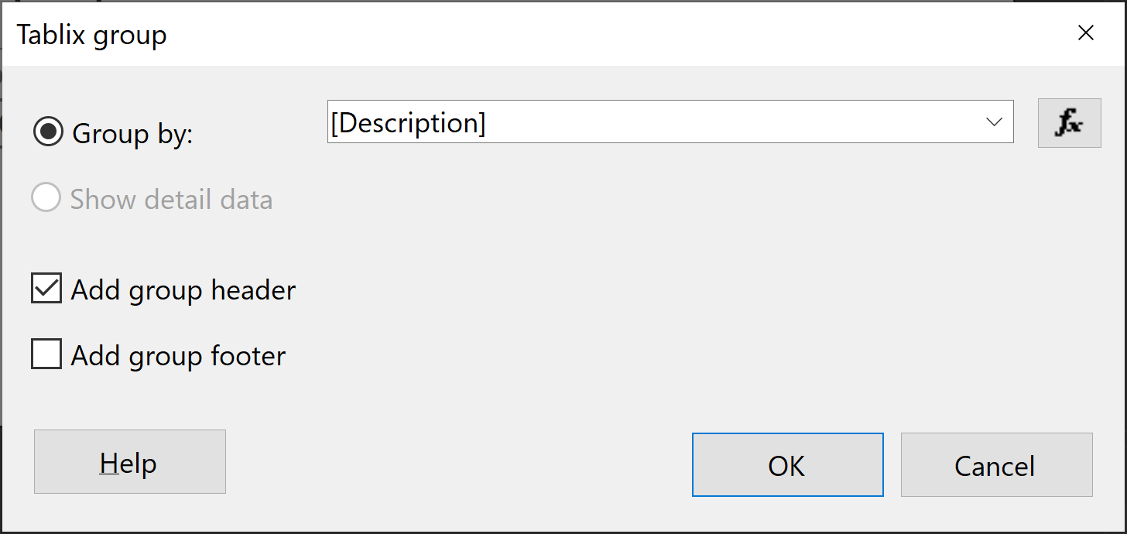
2. Add Row Group (II)
Select Add group header checkbox.
A tablix provides the capabilities of a table and a matrix combined into one. When we selected a table from the toolbox, what we really did was select a template that creates a tablix that functions like a table.

Slide 7
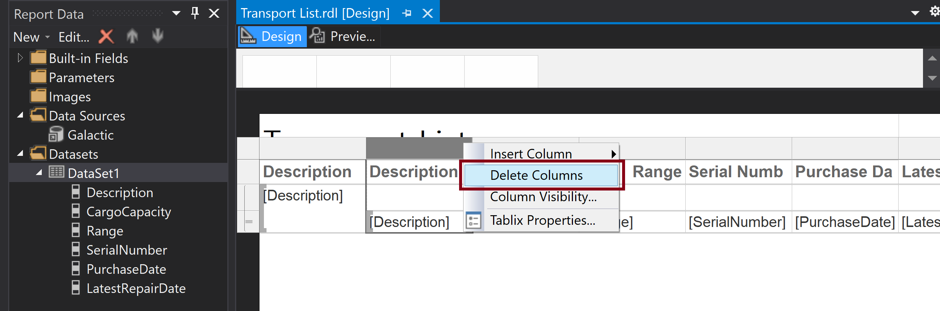
3. Delete a Column
Right click a column header.

Slide 8
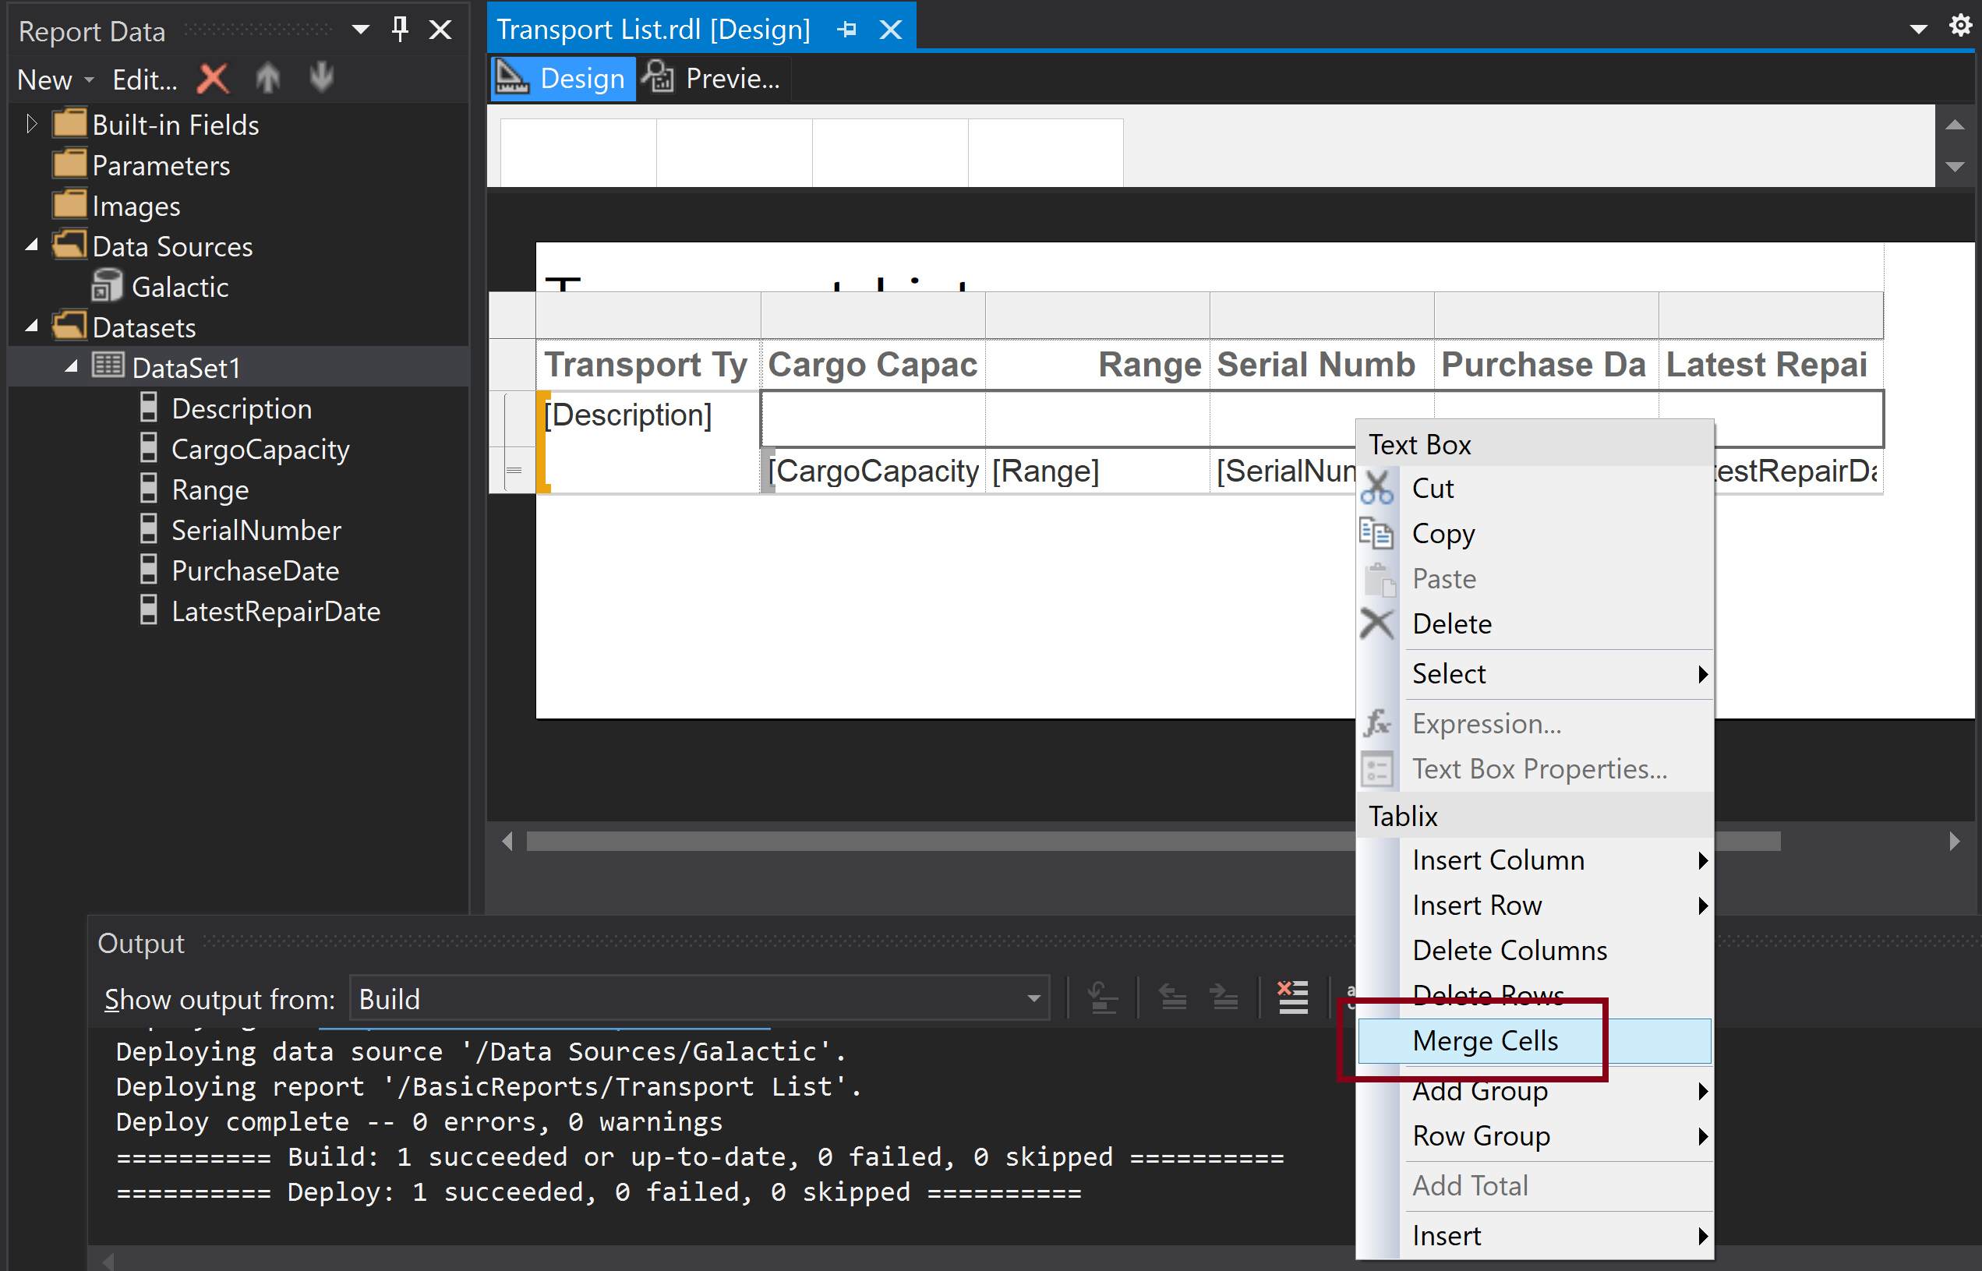
4. Merge Cells
Hold down Shift then right click.

Slide 9
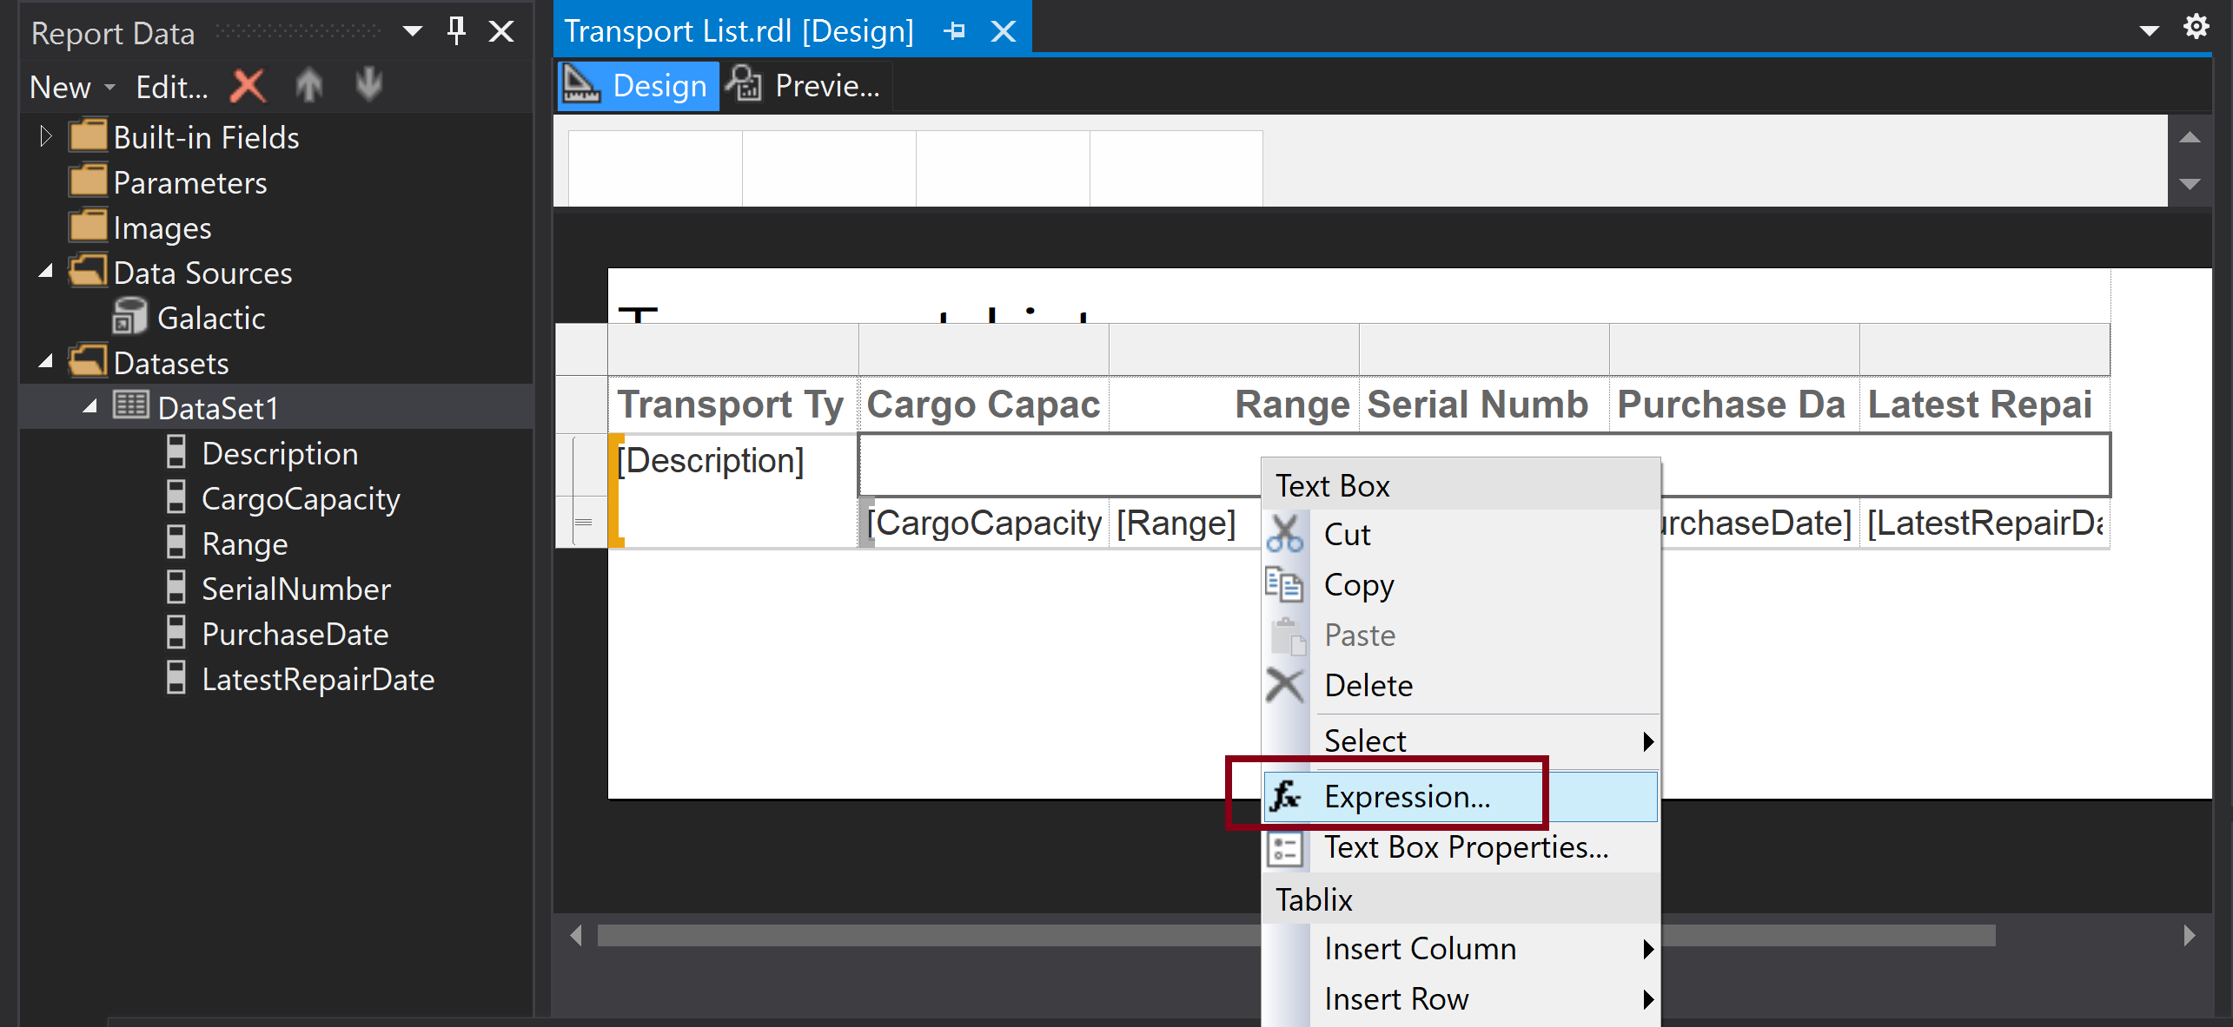
5. Add an Expression (I)
Right click a cell.

Slide 10
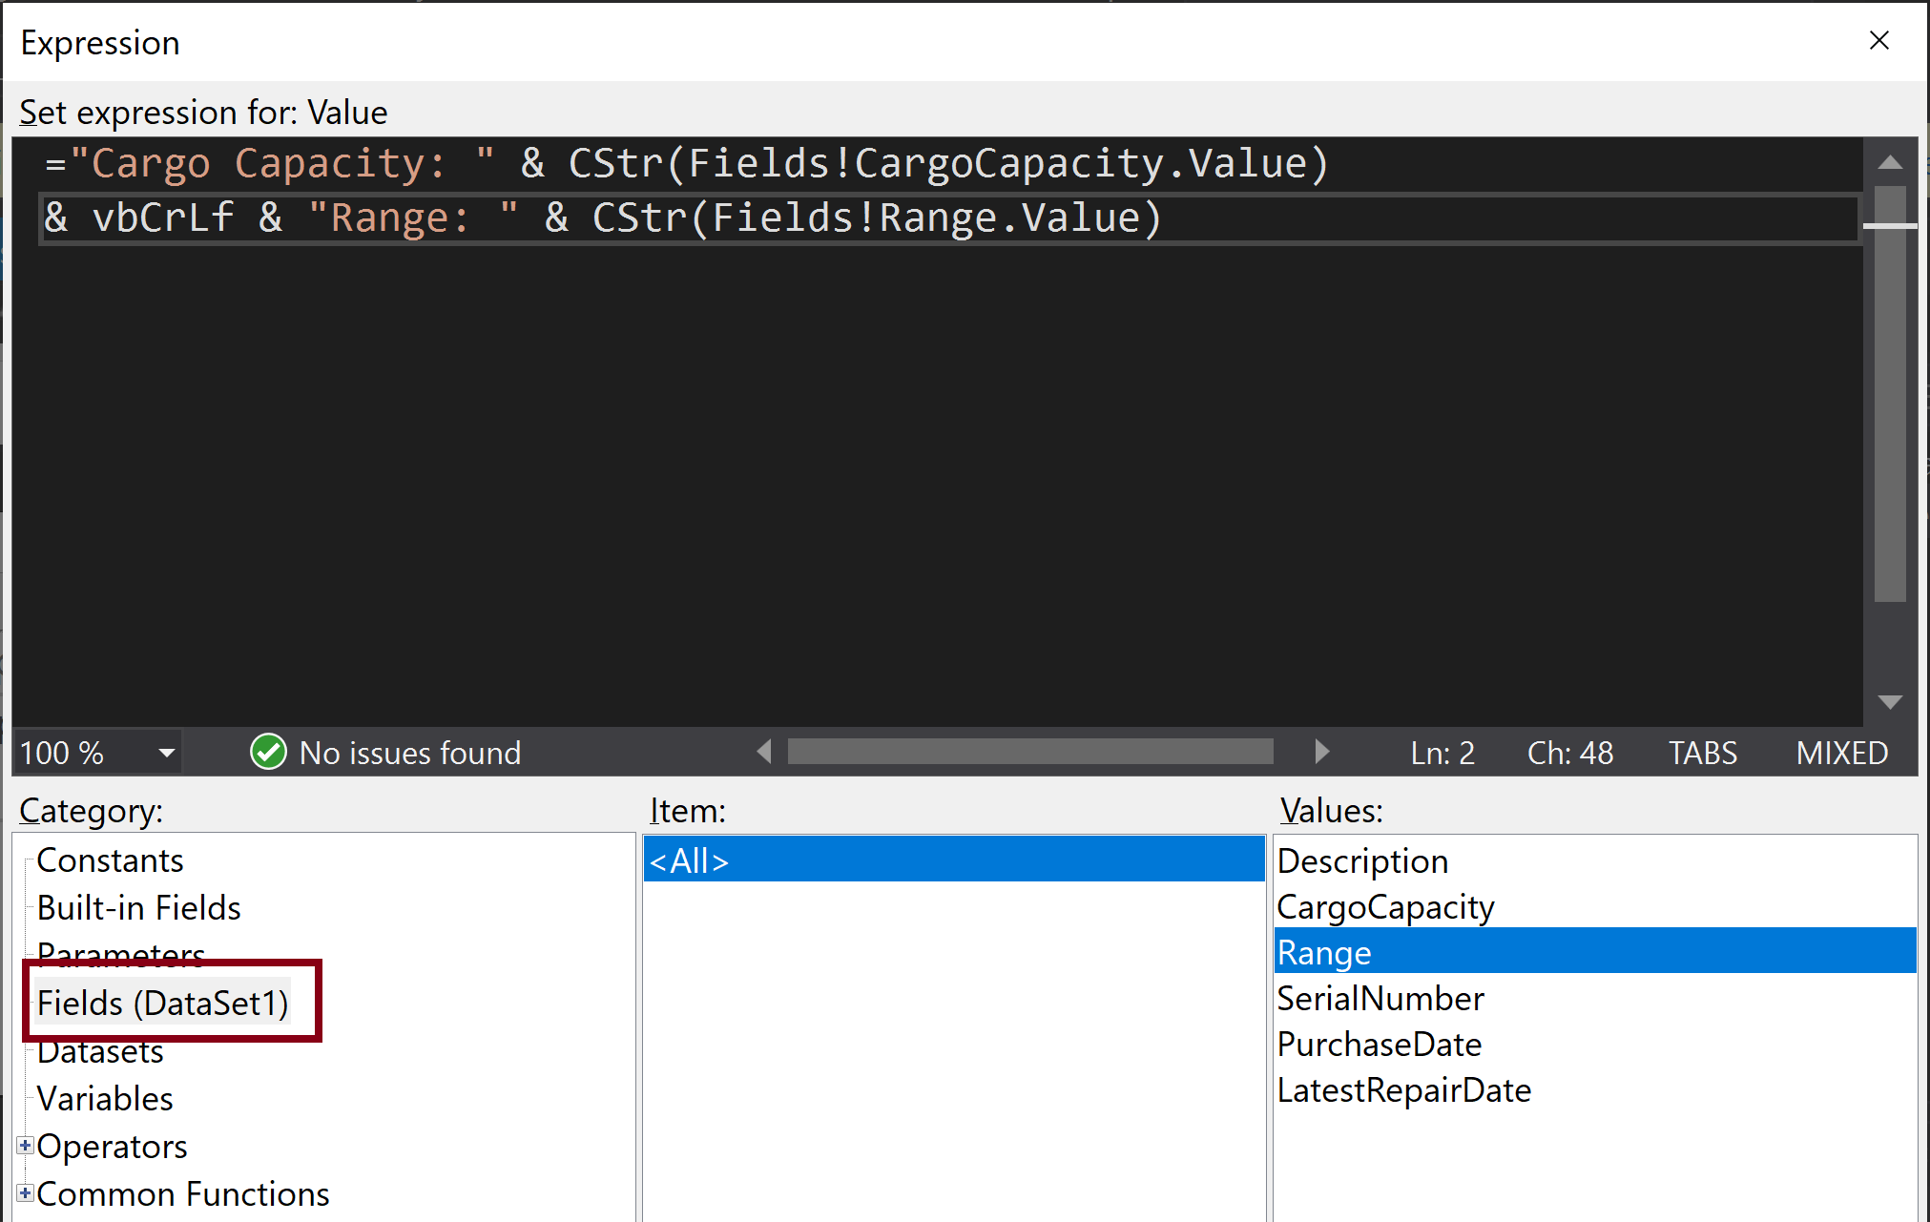
6. Add an Expression (I)
="Cargo Capacity: " & CStr(Fields!CargoCapacity.Value)
& vbCrLf & "Range: " & CStr(Fields!Range.Value)

Slide 11
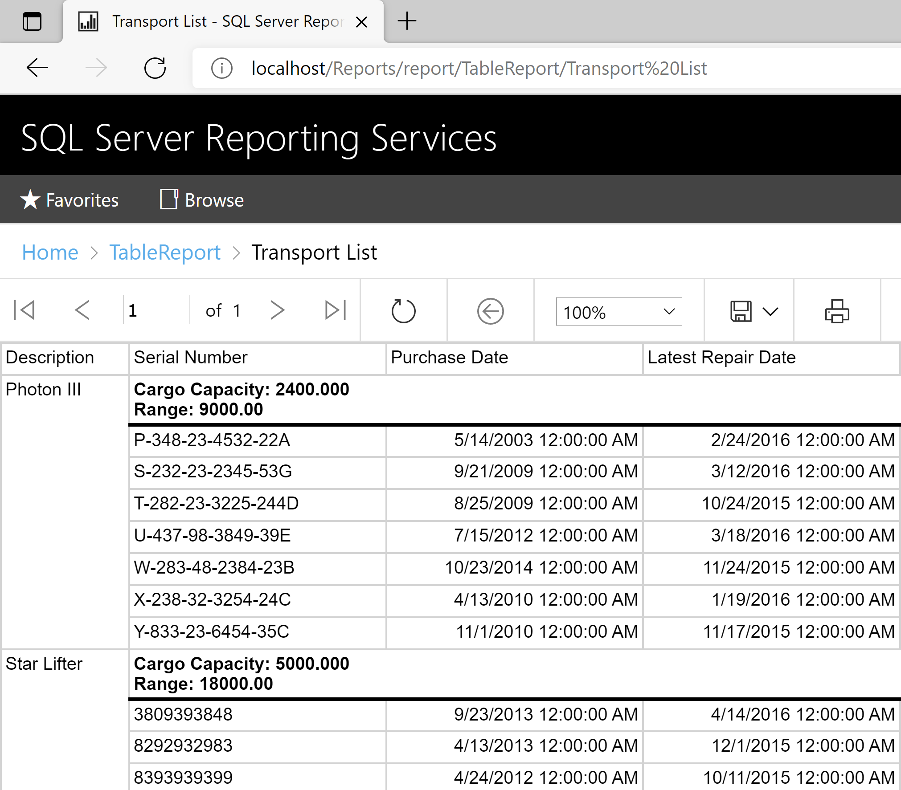
7. Test the Deployed Report
http://localhost/Reports/report/TableReport/Transport%20List

Slide 12

Thank You & See You Again

